Slide 1
Computer Architecture Lecture 1
Introduction

Slide 2
References
Google Class Code: nmver2b
Computer Architecture and Organization
Hayes J.P., McGraw-Hill.
Computer organization and design: The hardware/software interface
Patterson D.A., Hennessy J.L., Morgan Kaufmann.

Slide 3
What is Computer Architecture?
Programmer’s view: a pleasant environment
Operating system’s view: a set of resources (hardware & software)
System architecture view: a set of components
Compiler’s view: an instruction set architecture with OS help
Microprocessor architecture view: a set of functional units
VLSI designer’s view: a set of transistors implementing logic
Mechanical engineer’s view: a heater!

Slide 4
Definition of computer Architecture
In computer engineering, computer architecture is a set of rules and methods that describe the functionality, organization, and implementation of computer systems. Some definitions of architecture define it as describing the capabilities and programming model of a computer but not a particular implementation. In other descriptions computer architecture involves instruction set architecture design, microarchitecture design, logic design, and implementation.
Computer architecture = Instruction set architecture + Machine organization + Hardware

Slide 5
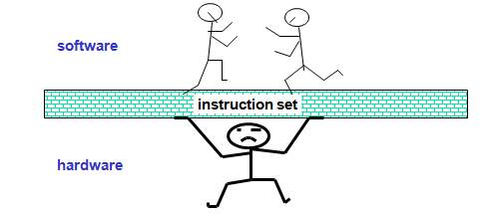
Instruction Set Architecture (ISA)
The Instruction Set Architecture (ISA) is the part of the processor that is visible to the programmer or compiler writer.
The ISA serves as the boundary between software and hardware.

Slide 6
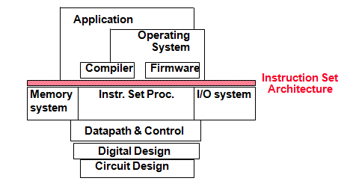
Cont.
Example: MIPS
Desired properties
Convenience (from software side)
Efficiency (from hardware side)
Notes:
Microprocessor without Interlocked Pipeline Stages (MIPS) is a type of microprocessor architecture that uses a Reduced Instruction Set Computing (RISC) approach. MIPS was designed in 1984 by researchers at Stanford University.
‹#›

Slide 7
Cont.
Part of computer architecture related to programming
Define registers
R1, R2,...
Define data transfer modes (instructions) between registers, memory and I/O
e.g. MOV, ADD, INC
There should be sufficient instructions to efficiently translate any program
e.g. MOV, ADD, INC

Slide 8
Machine Organization
High-level aspects of a computer’s design
Principal components: memory, CPU, I/O, …
How components are interconnected
How information flows between components
e.g. AMD Opteron 64 and Intel Pentium 4: same ISA but different organizations
Notes:
‹#›

Slide 9
Hardware
Detailed logic design and the packaging technology of a computer
E.g. Pentium 4 and Mobile Pentium 4: nearly identical organizations but different hardware details
Notes:
Packaging technology is the process of using hardware, software, or procedures to package integrated circuit products into multi-chip or single-chip packages
‹#›

Slide 10
Types of computers and their applications
Desktop
Run third-party software
Office to home applications
Servers
Modern version of what used to be called mainframes, minicomputers and supercomputers
Large workloads
Built using the same technology in desktops but higher capacity
Expandable
Scalable
Reliable
Large spectrum: from low-end (file storage, small businesses) to supercomputers (high end scientific and engineering applications)
Gigabytes to Terabytes to Petabytes of storage
Examples: file servers, web servers, database servers

Slide 11
Cont.
Embedded
Microprocessors everywhere! (washing machines, cell phones, automobiles, video games)
Run one or a few applications
Specialized hardware integrated with the application
Usually stringent limitations (battery power)
High tolerance for failure
Becoming ubiquitous
Engineered using processor cores
The core allows the engineer to integrate other functions into the processor for fabrication on the same chip
Using hardware description languages: Verilog, VHDL

Slide 12
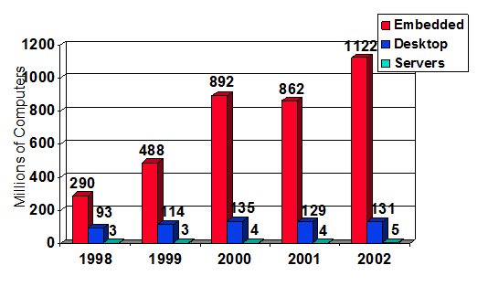
What is the Market ?

Slide 13
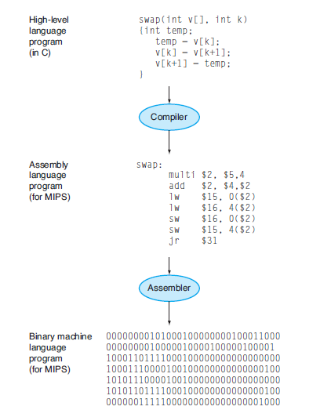
From a High-Level Language to the Language of Hardware

Slide 14
Evolution…
In the beginning there were only bits… and people spent countless hours trying to program in machine language
01100011001 011001110100
Finally before everybody went insane, the assembler was invented: write in mnemonics called assembly language and let the assembler translate (a one to one translation)
Add A,B

Slide 15
Evolution…Cont.
Assembler is a program that translates a symbolic version of instructions into the binary version.
This program translates a symbolic version of an instruction into the binary version. For example, the programmer would write
add A, B
and the assembler would translate this notation into
1000110010100000
This instruction tells the computer to add the two numbers A and B.

Slide 16
Evolution…Cont.
The name coined for this symbolic language, still used today, is assembly language. In contrast, the binary language that the machine understands is the machine language.
Assembly language requires the programmer to write one line for every instruction that the computer will follow, forcing the programmer to think like the computer.
This wasn’t for everybody, obviously… (imagine how modern applications would have been possible in assembly), so high-level language were born (and with them compilers to translate to assembly, a many-to-one translation)

Slide 17
Evolution…Cont.
A compiler enables a programmer to write this high-level language expression:
A+B
The compiler would compile it into this assembly language statement:
add A,B
The assembler would translate this statement into the binary instructions that tell the computer to add the two numbers A and B.

Slide 18
Benefits of High Level Programming Language
First, they allow the programmer to think in a more natural language, using English words and algebraic notation, resulting in programs that look much more like text.
Moreover, they allow languages to be designed according to their intended use. Hence, Fortran was designed for scientific computation, Cobol for business data processing, Lisp for symbol manipulation, and so on.
There are also domain-specific languages for even narrower groups of users, such as those interested in simulation of fluids, for example.

Slide 19
Cont.
The second advantage of programming languages is improved programmer productivity.
One of the few areas of widespread agreement in software development is that it takes less time to develop programs when they are written in languages that require fewer lines to express an idea.

Slide 20
Cont.
The final advantage is that programming languages allow programs to be independent of the computer on which they were developed, since compilers and assemblers can translate high-level language programs to the binary instructions of any computer.
These three advantages are so strong that today little programming is done in assembly language.

Slide 21
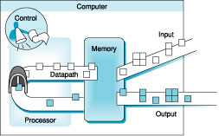
Organization of a Computer

Slide 22
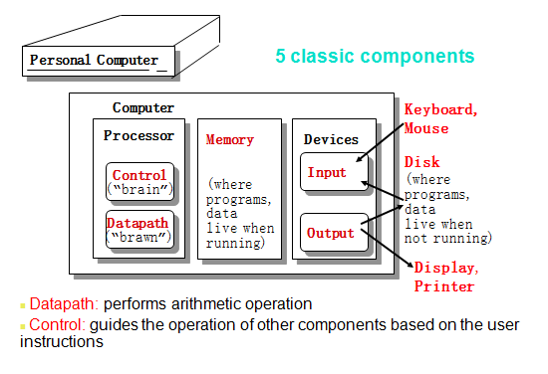
Anatomy of a Computer

